Slide 1

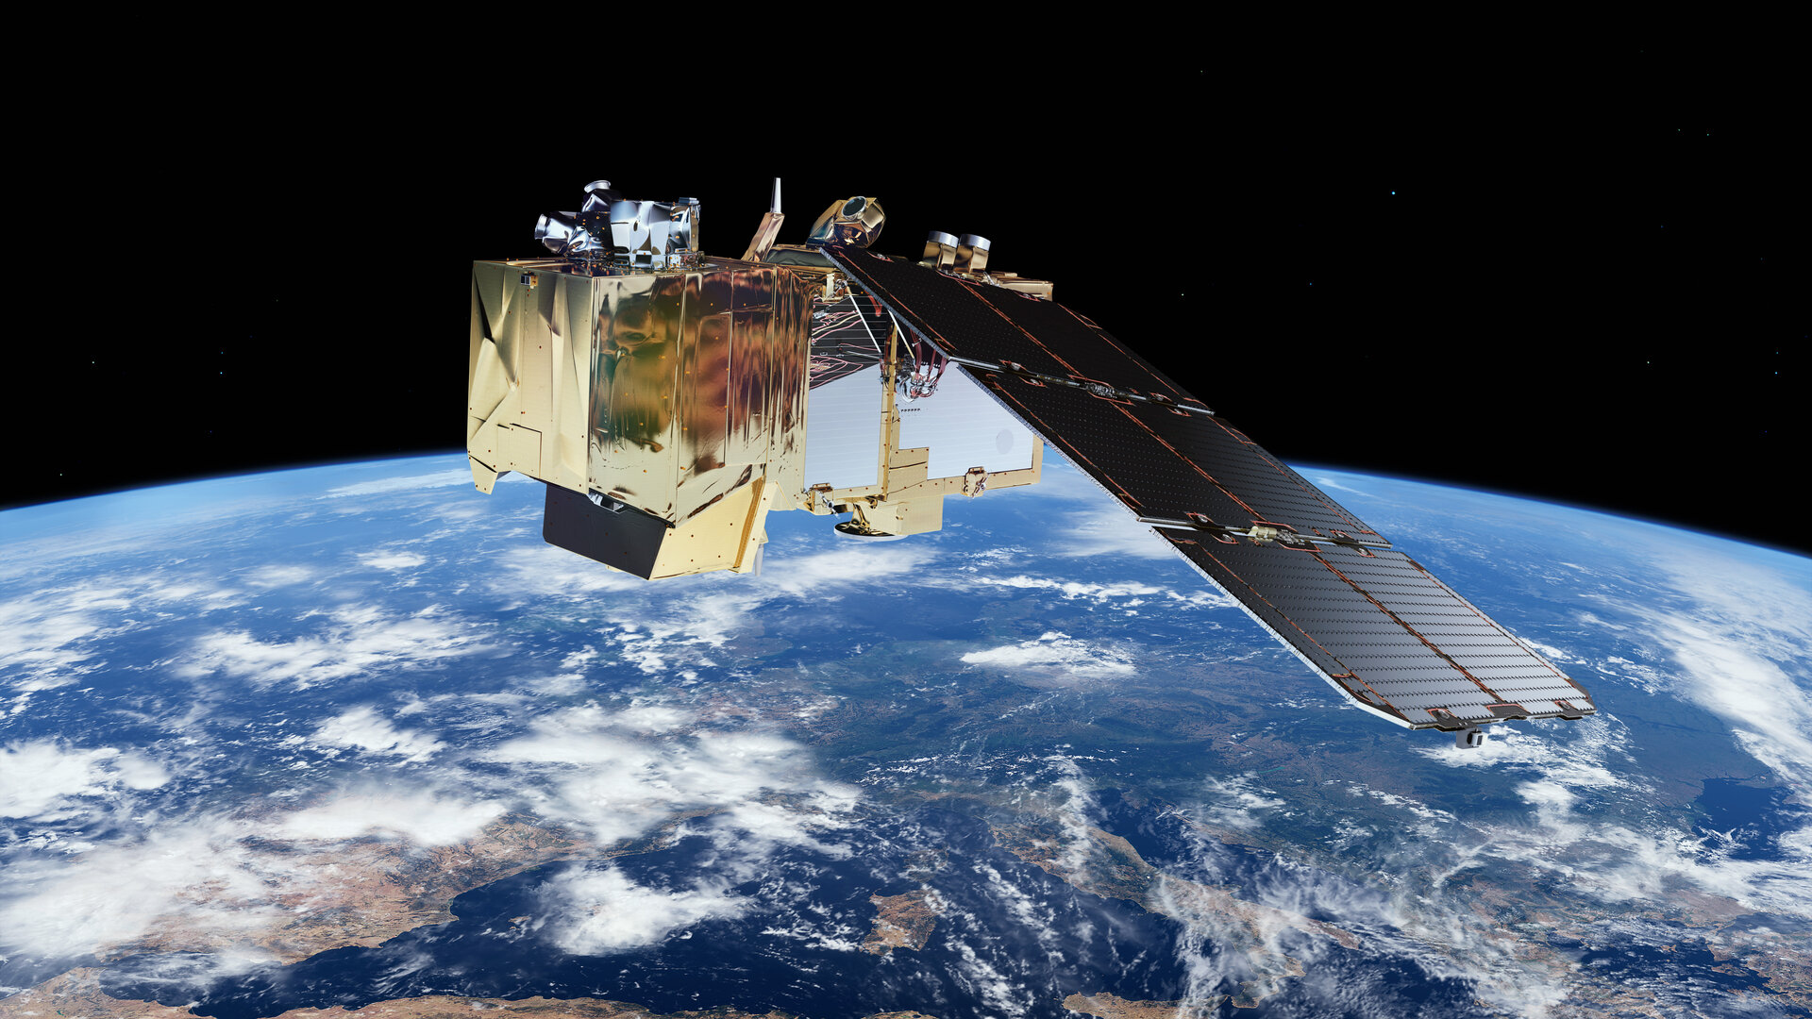
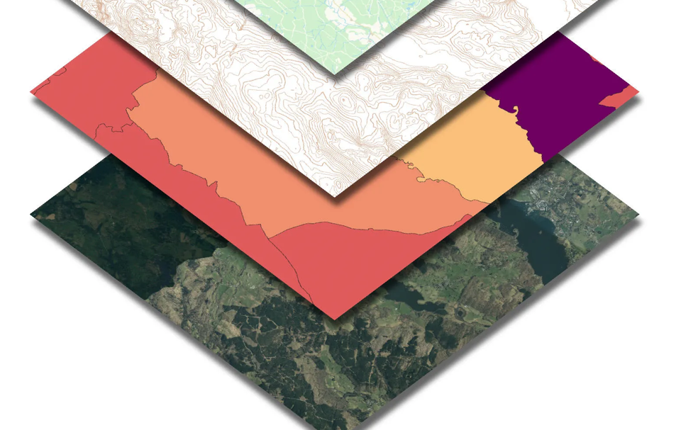
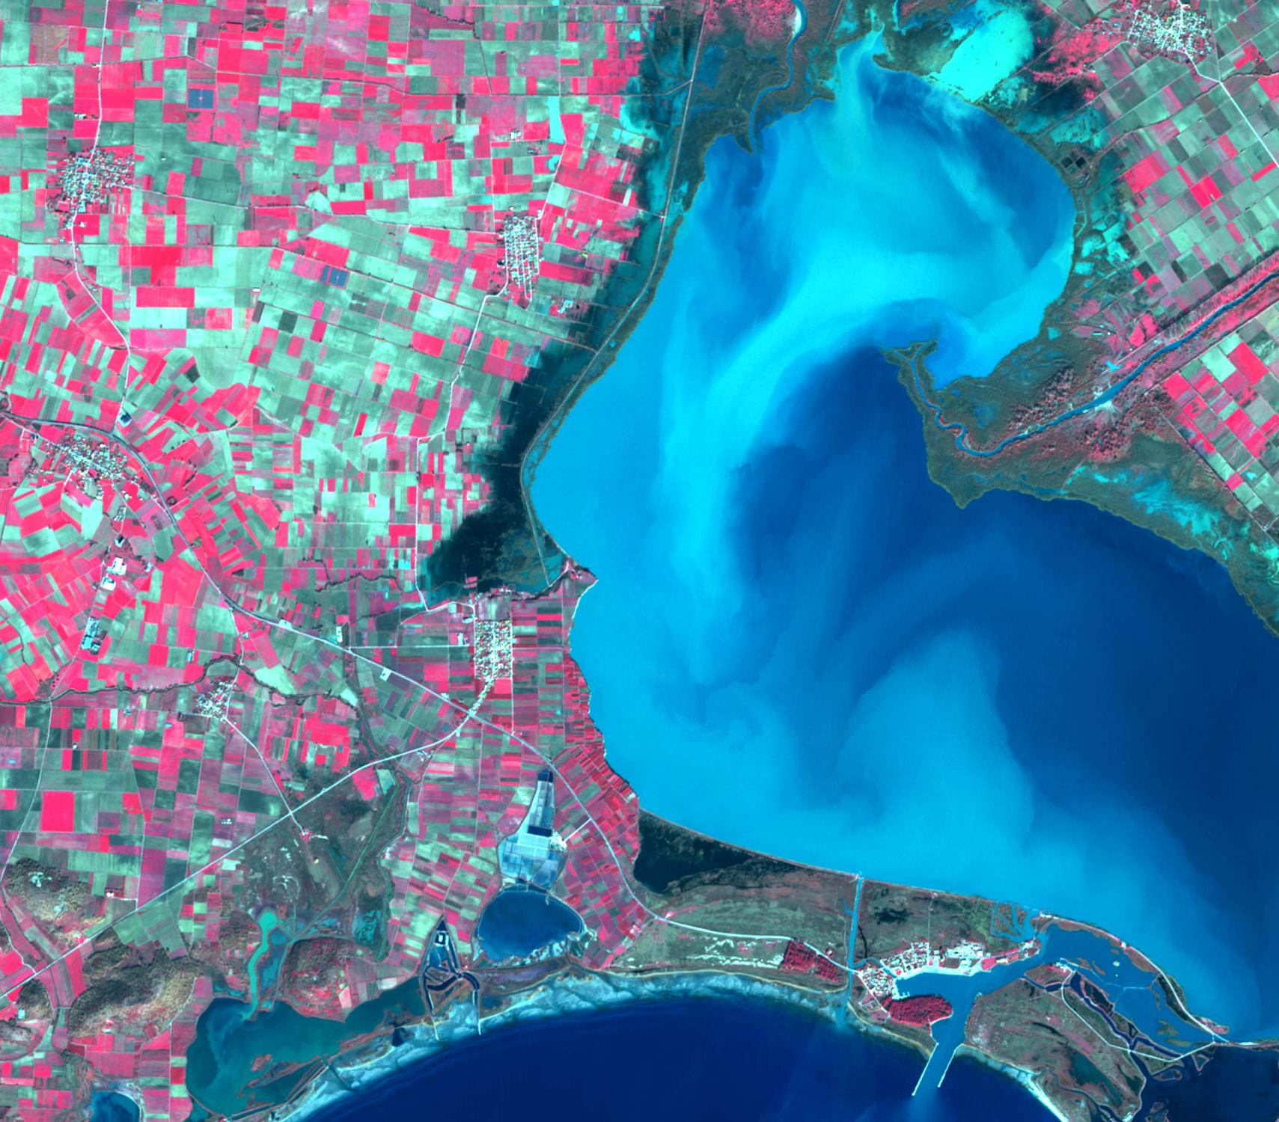
Introduction to AI for Geospatial
Songyan Zhu

Slide 2
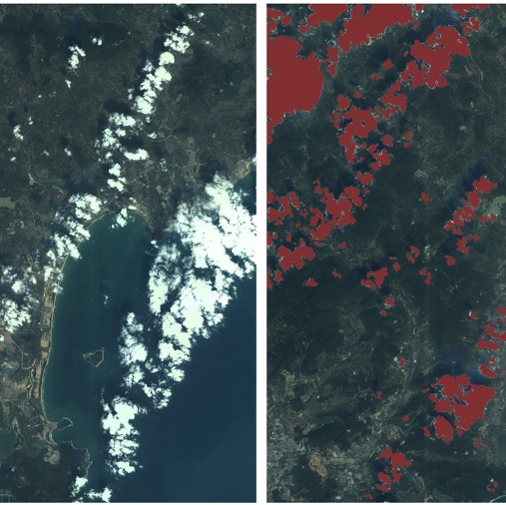
What is Geospatial AI?
Definition: Artificial Intelligence (AI) is a field of computer science that enables machines to perceive, learn, and reason like human.
The role of AI in spatial analysis:
Automating Data Processing
Pattern Recognition
Predictive Modelling
Li et al. (2020)

Slide 3
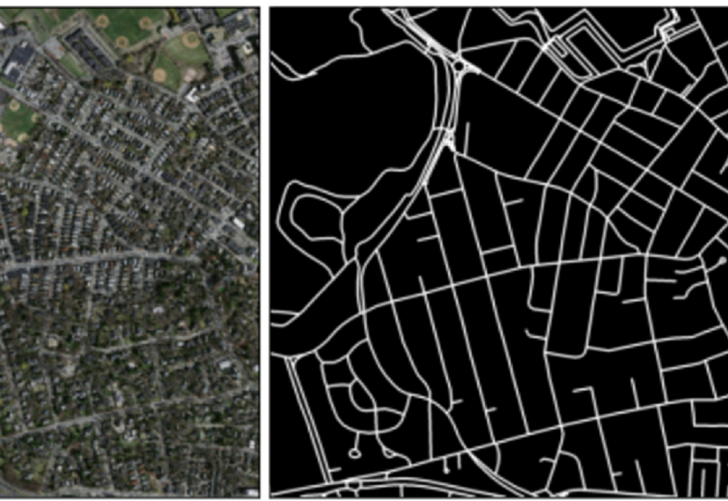
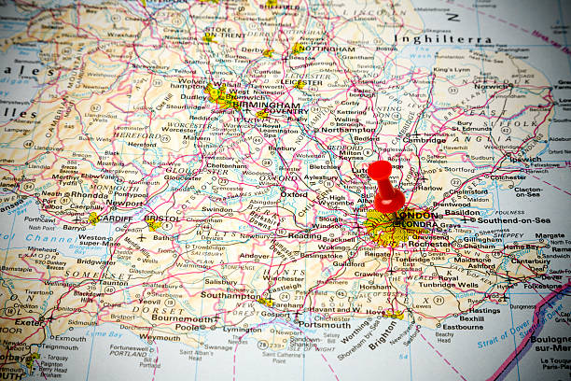
Why Geospatial AI?
Address challenges in traditional GIS and remote sensing.
Notes:
Munawar, Hafiz Suliman, et al. "Road Network Detection from Aerial Imagery of Urban Areas Using Deep ResUNet in Combination with the B-snake Algorithm." Human-Centric Intelligent Systems 3.1 (2023): 37-46.

Slide 4
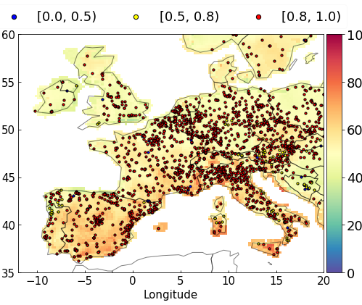
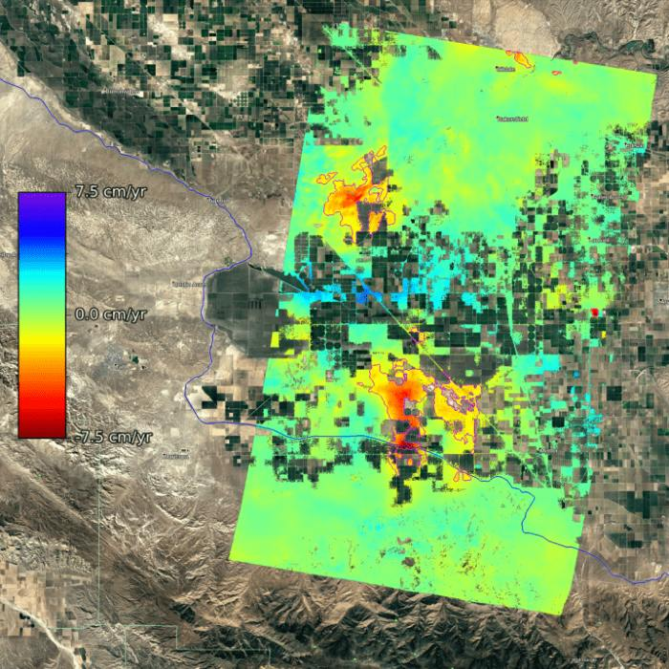
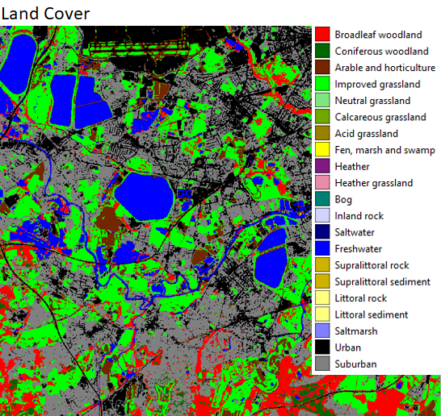
Real-World Applications of Geospatial AI
Land cover mapping
Air pollution modelling
Disaster prediction
Notes:
geological displacement rates (https://www.ualberta.ca/en/science/news/2020/march/machine-learning-disaster-prediction.html)

Slide 5
What’s the difference between AI, Machine Learning, and Deep Learning?
AI is the broader concept of enabling a machine to mimic human intelligence
Expert systems, ML, etc.
ML refers to algorithms automatedly to ‘learn’ knowledge from data
Random forest, XGBoost, shallow-layer (<3) NN
DL is a subset of ML with multiple-layers of processing
Deep neural networks (e.g., CNN, LSTM, Transformer) and deep forest
Notes:
Expert system is AI but not ML, e.g., Deep Blue (the first computer to beat a world chess champion in 1997) was largely hard-coded with chess knowledge.

Slide 6
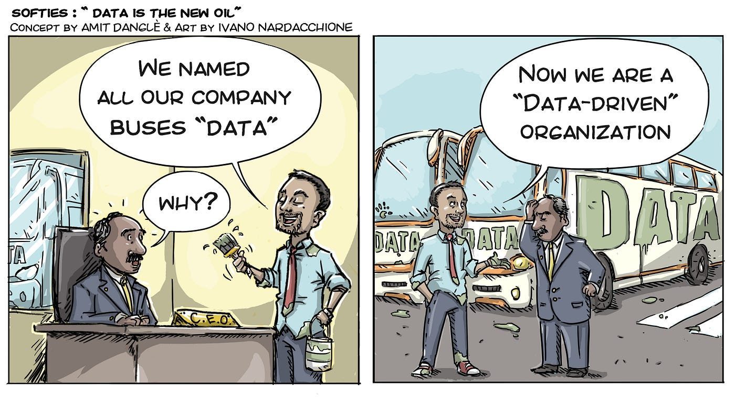
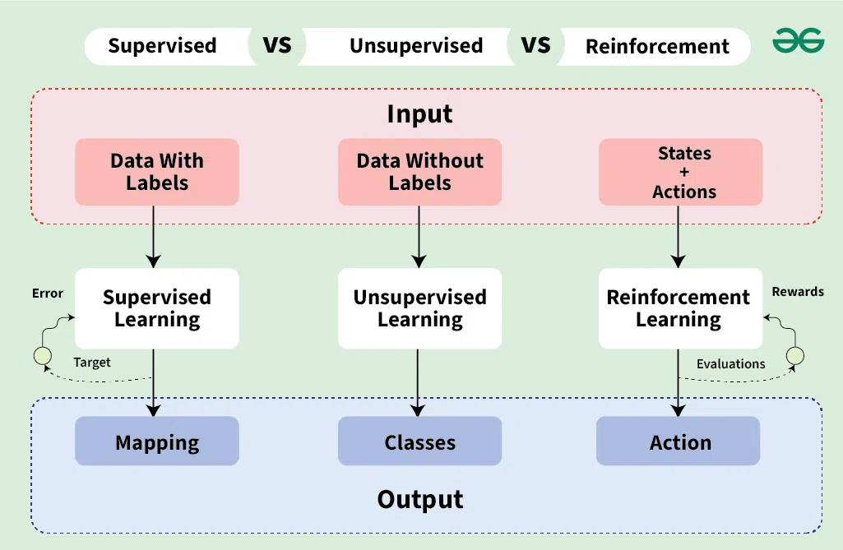
Basic AI Concepts
Learning types:
Supervised (e.g., land cover classification)
Unsupervised (e.g., clustering urban areas)
Reinforcement (e.g., traffic optimisation)
Role of data in AI

Slide 7

Types of Machine Learning

Slide 8
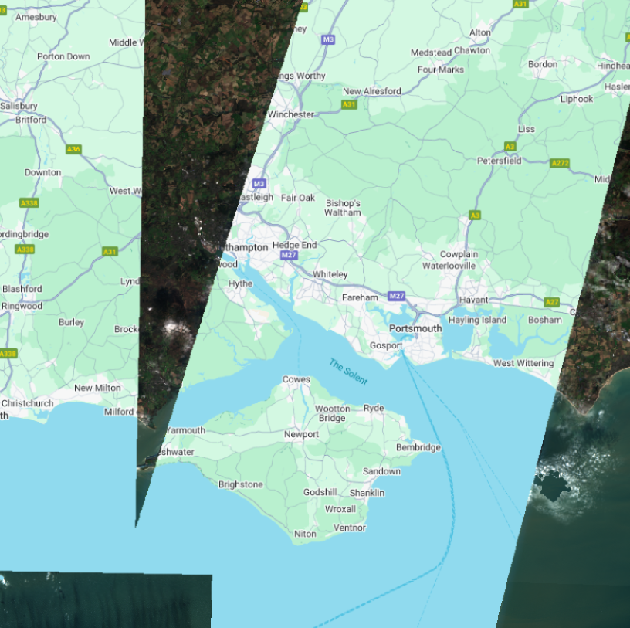
Geospatial Data & Challenges for AI
Data types: Raster, vector, time-series
Common issues: High dimensionality, big data, and data missing

Slide 9
Pre-processing Geospatial Data for AI
Data cleaning & normalisation – for deep learning mainly
Handling missing values
Labelling satellite imagery – for supervised

Slide 10
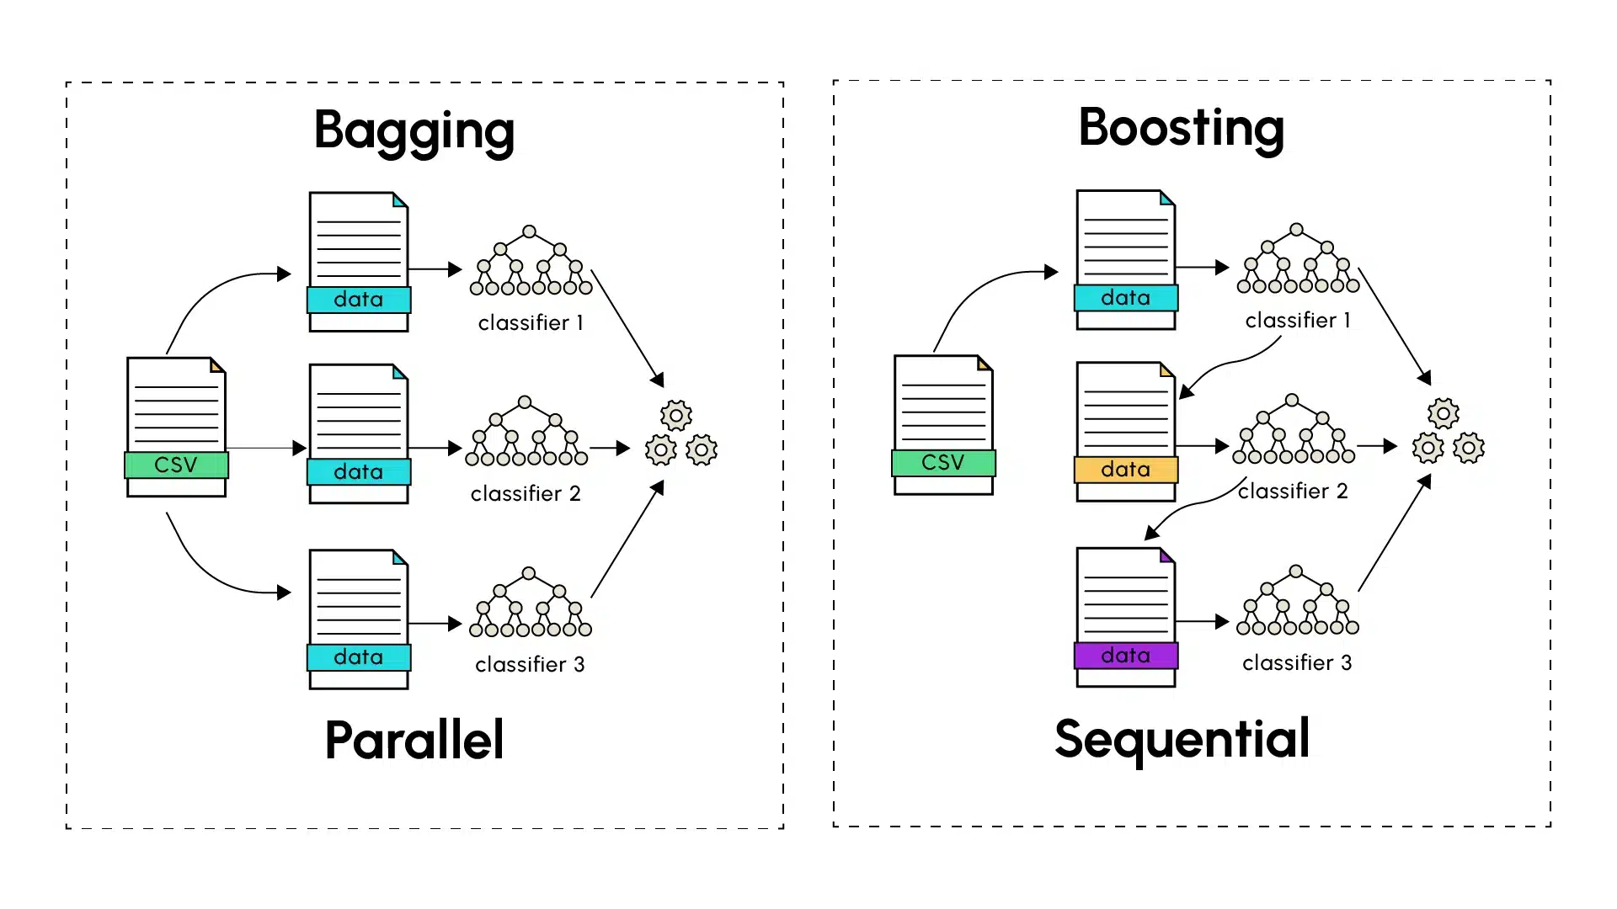
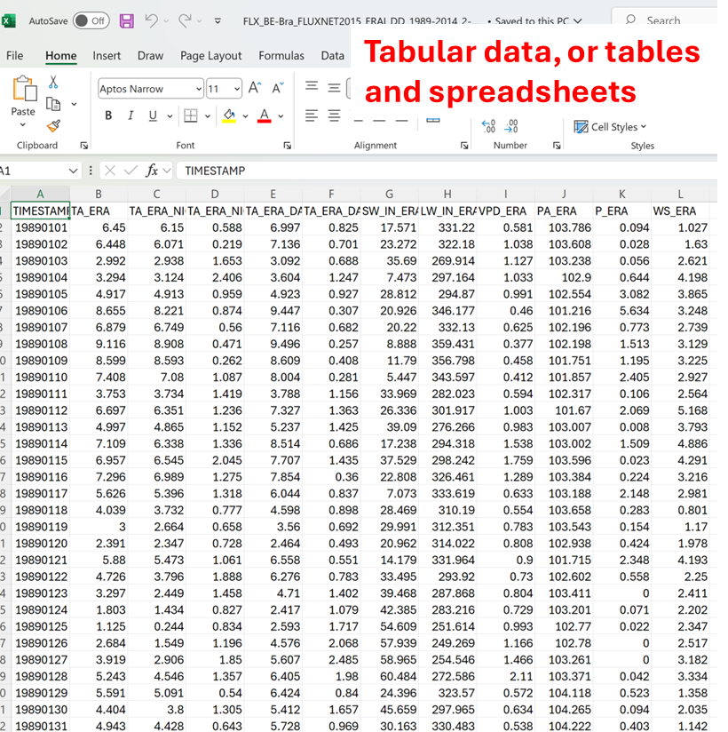
Traditional Machine Learning Models for Geospatial Data
Still have strength over deep learning for tabular data
Random Forests – bagging
XGBoost – boosting
Notes:
Ensemble Learning

Slide 11

Deep Learning for Remote Sensing
NOT THIS TRANSFORMER!!!
Computer vision:
CNN e.g., ResNet – shortcut
GAN
Examples: YOLO, U-Net
Natural language processing (NLP) for sequential data:
RNN (e.g., Seq2Seq)
LSTM – forget gate
Transformers – attention mechanism
Example: LLMs e.g., ChatGPT
Others:
e.g., Diffusion, Autoencoder

Slide 12
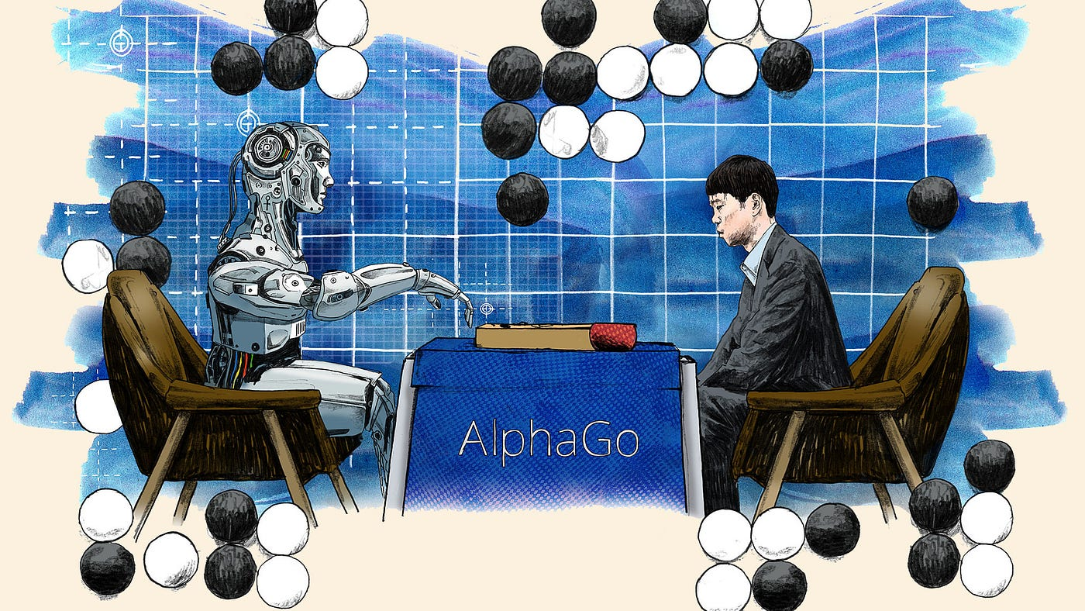
What did AlphaGo use?
Supervised learning (on human expert games)
Reinforcement learning (self-play)
Monte Carlo Tree Search (evaluate possible moves)

Slide 13
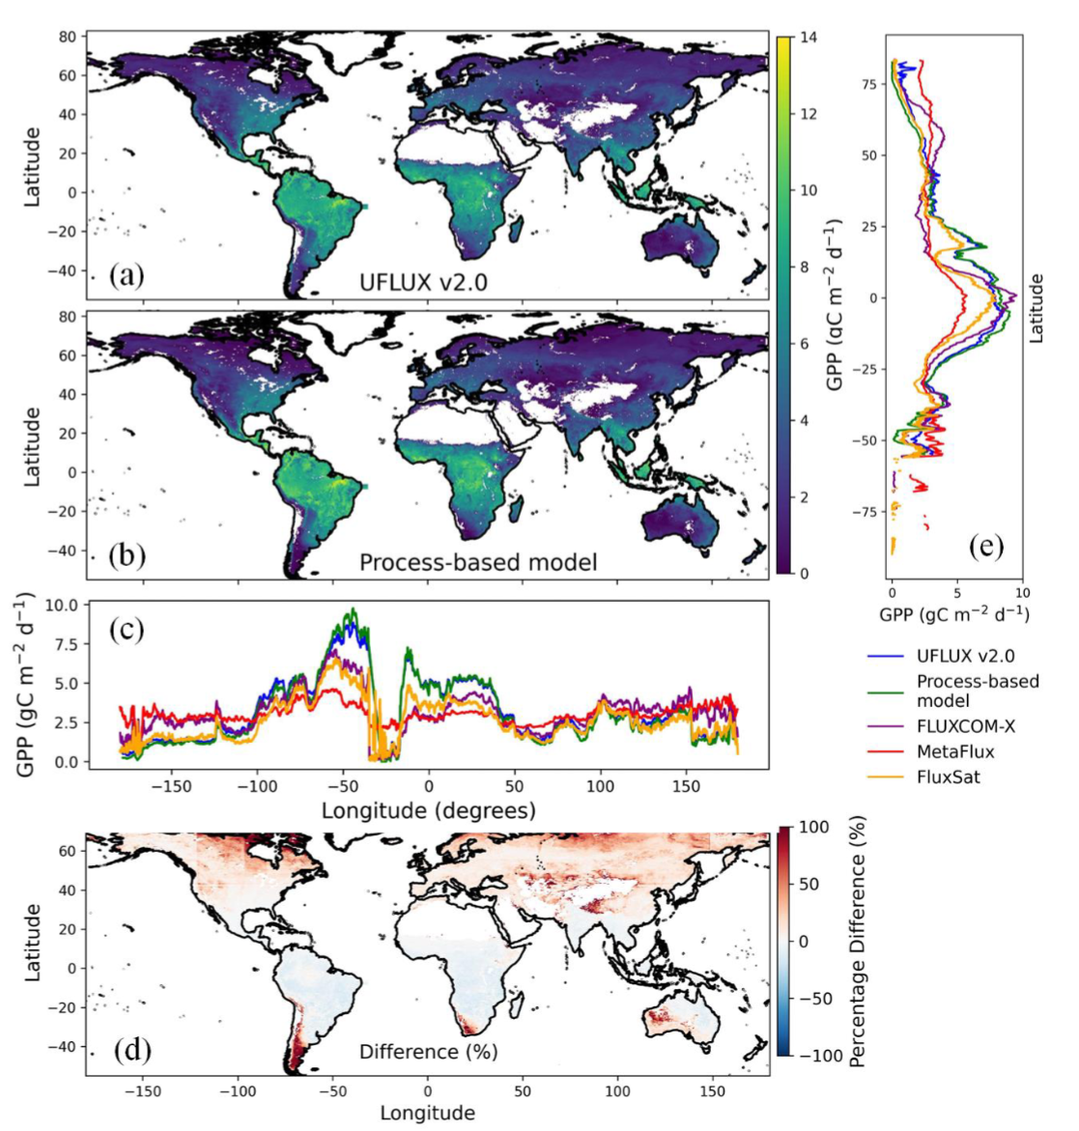
Hybrid AI Models (Physics-Informed AI)
Combining domain knowledge with AI

Slide 14
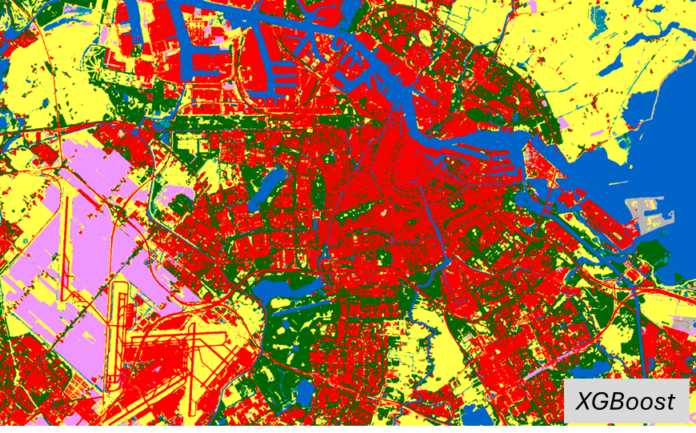
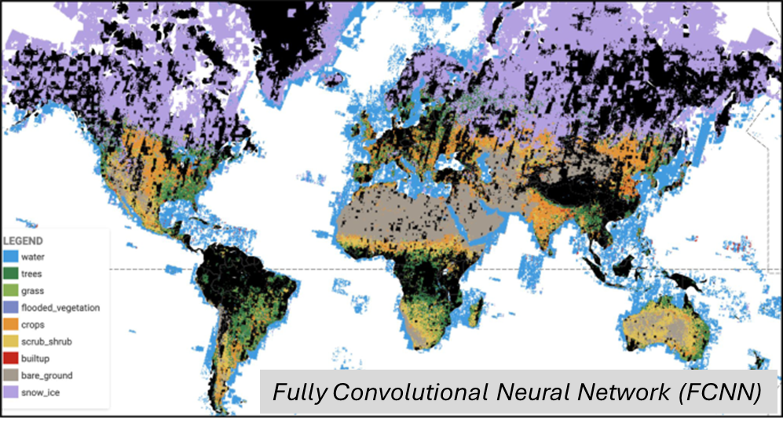
Land Cover Classification
Supervised ML and CNNs on satellite imagery
Google DynamicWorld (10 m)
ESA WorldCover (10 m)

Slide 15
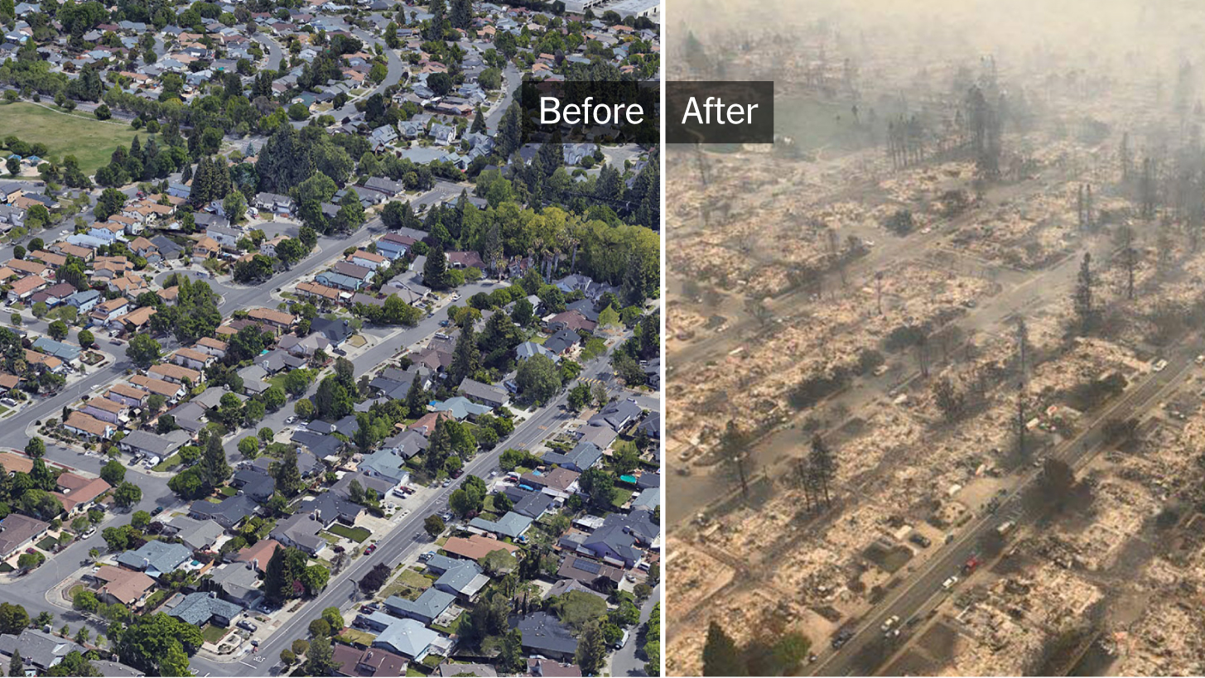
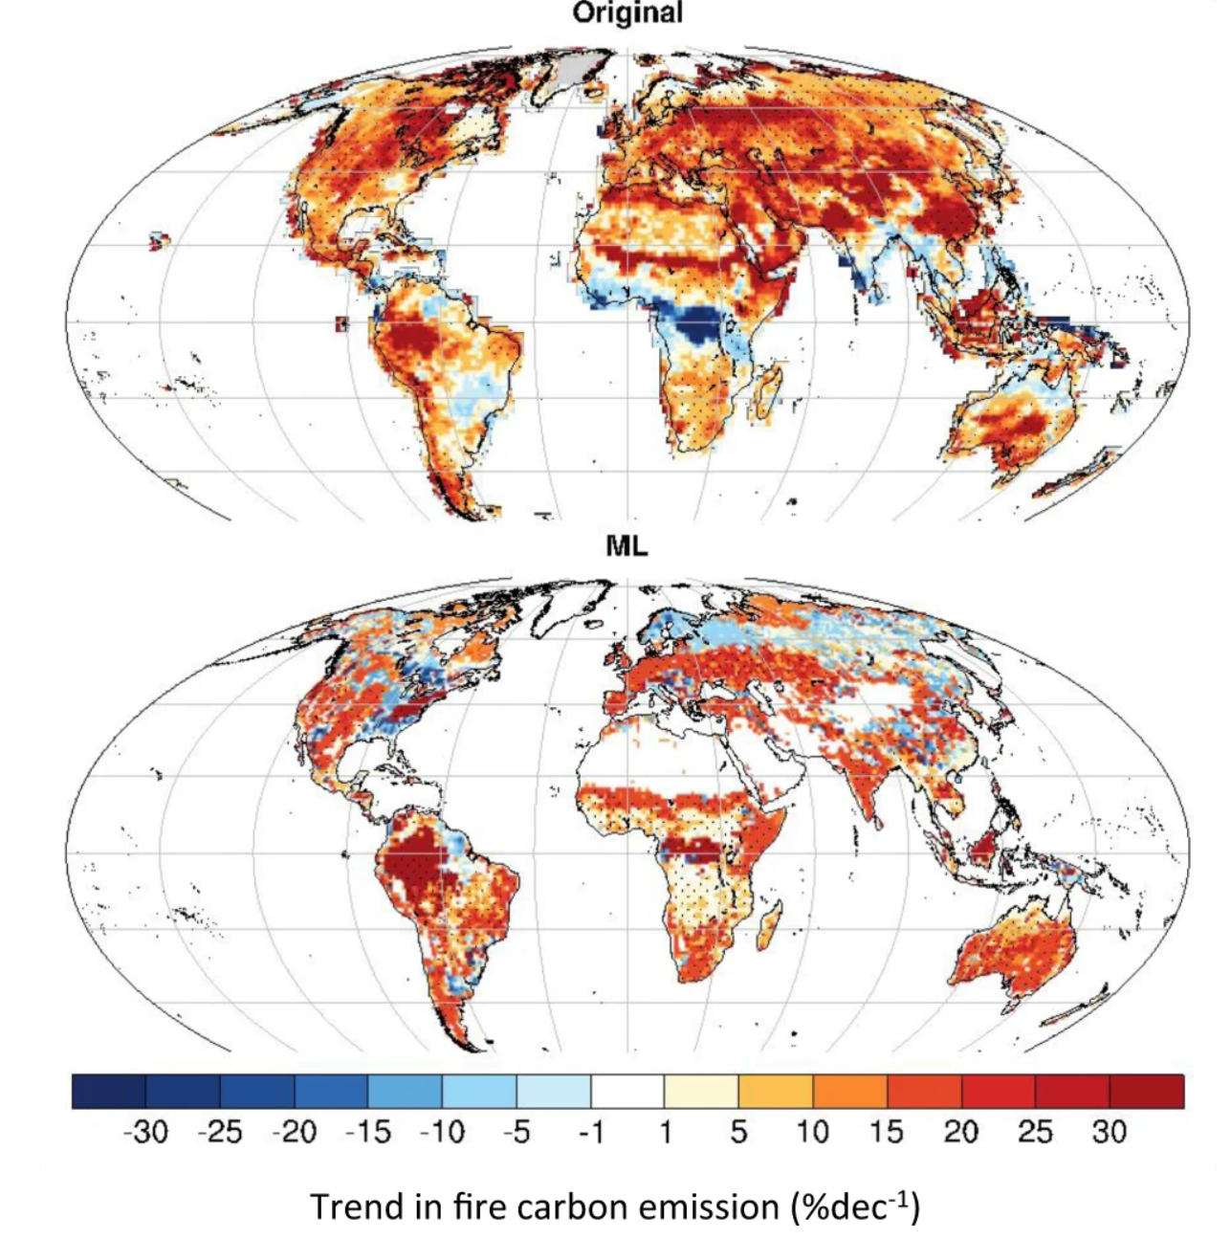
Wildfire Precaution?
Going byond post-analysis…

Slide 16
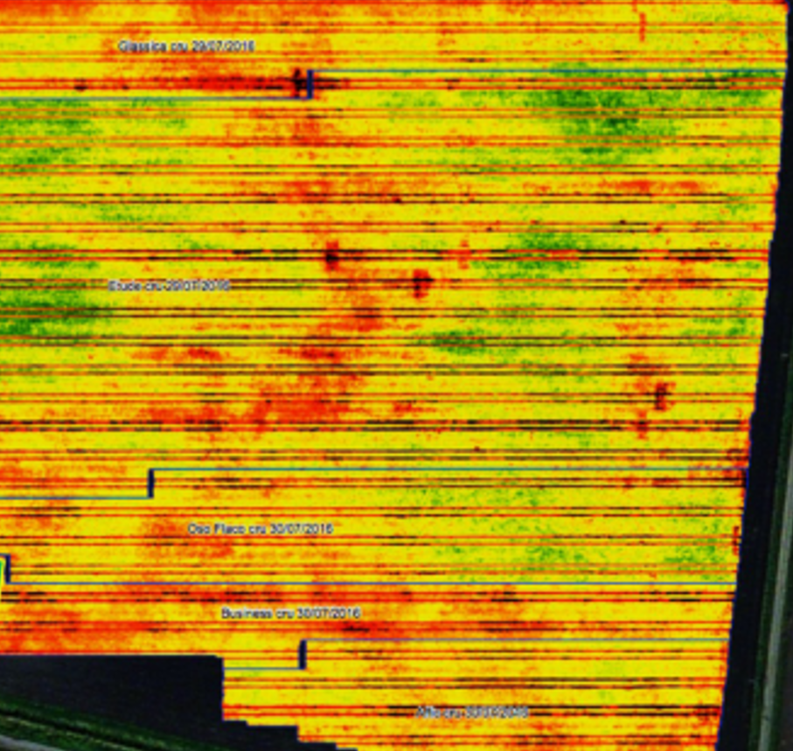
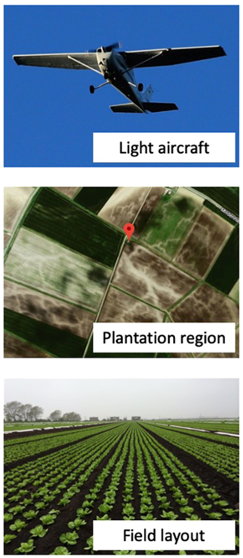
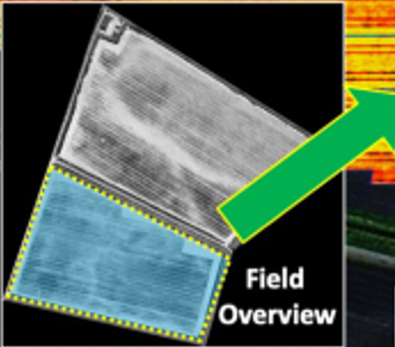
AI-inspired Precision Agriculture
Pest and disease detection
Crop yield estimation
Climate prediction

Slide 17
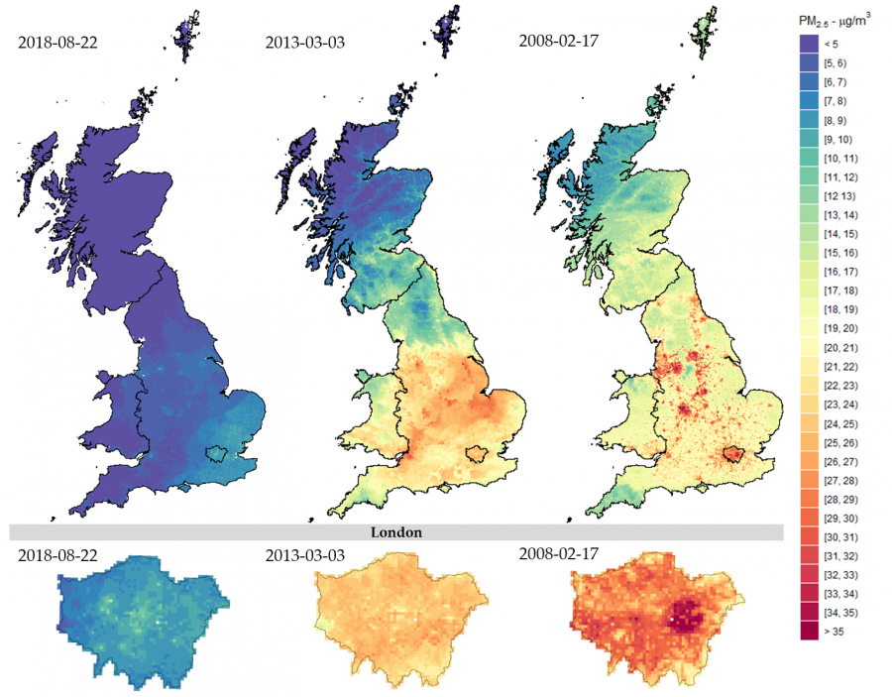
Air Pollution Prediction

Slide 18
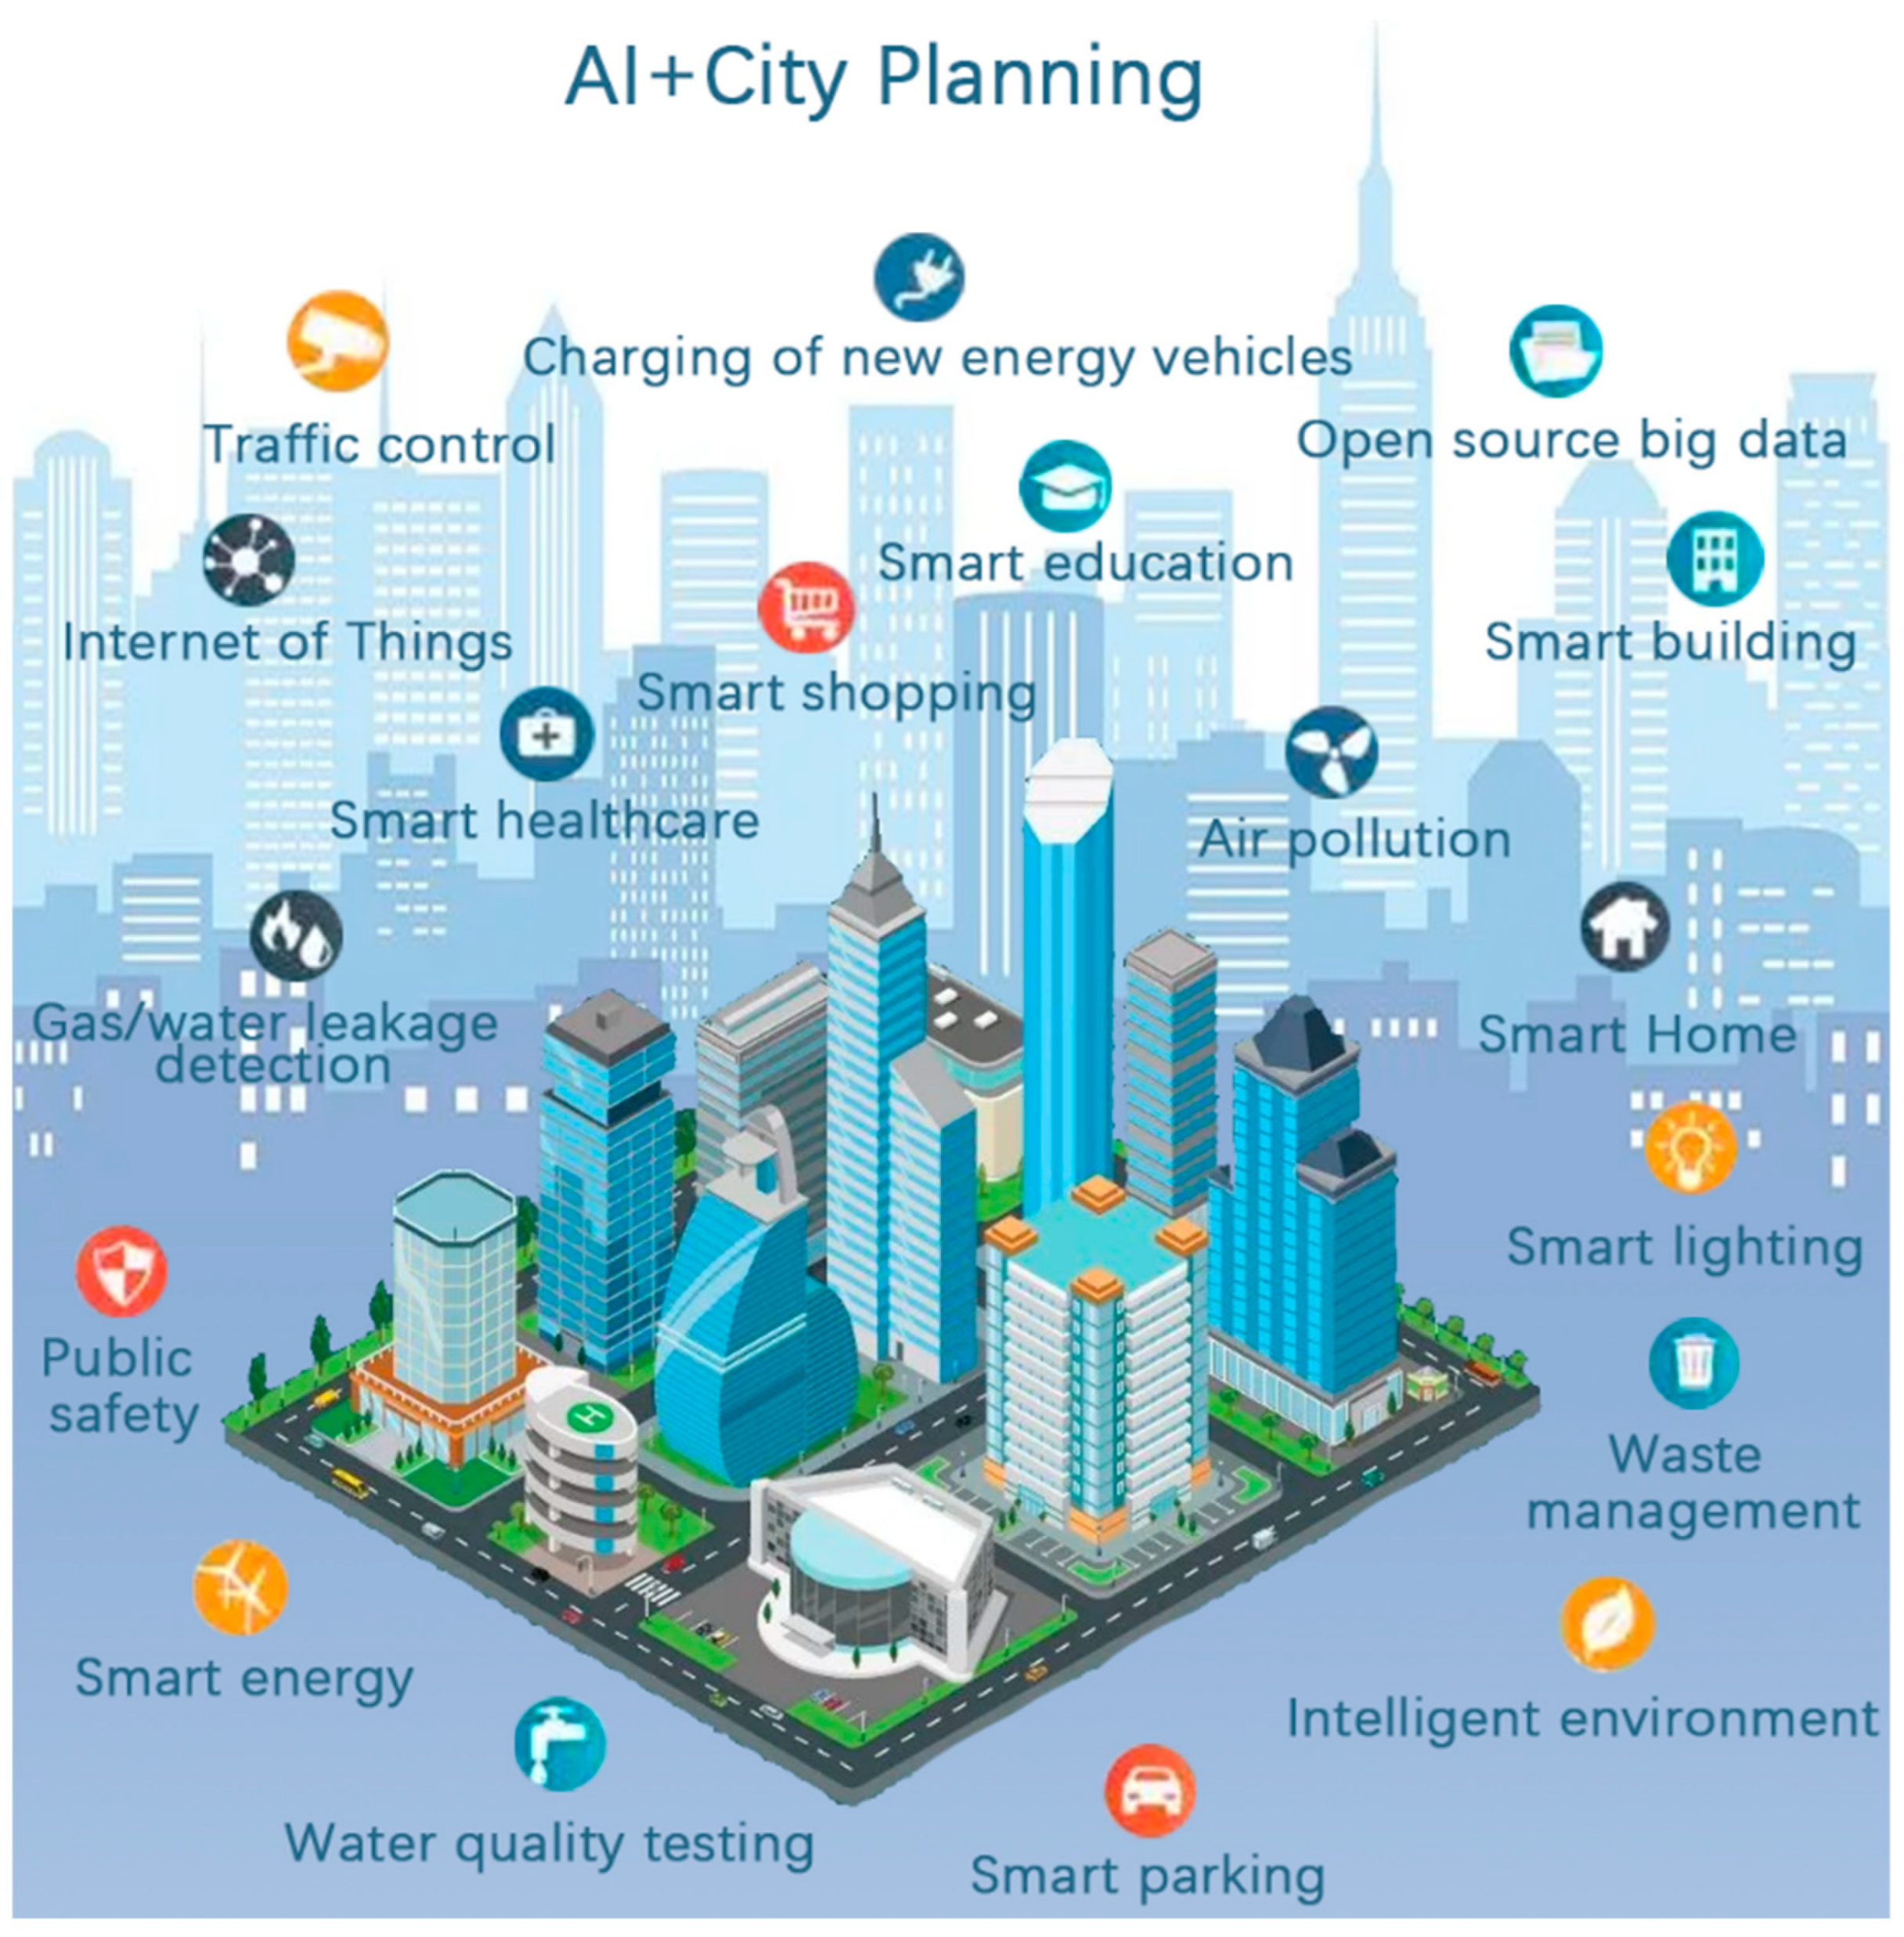
Geospatial AI and Smart City
More than remote sensing…

Slide 19
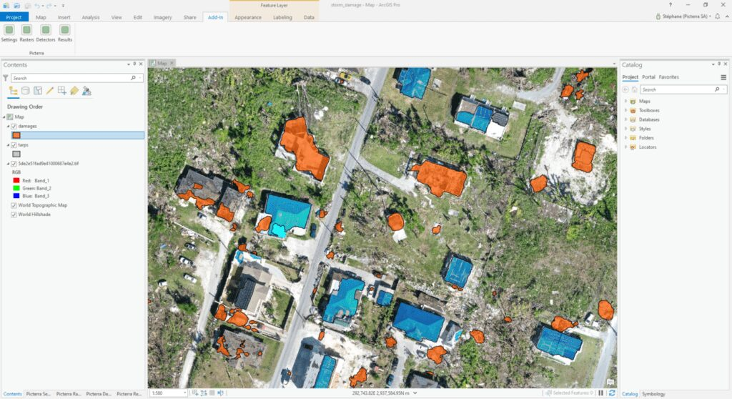
How AI is Integrated into GIS?
AI-powered geospatial analysis in GIS platforms

Slide 20
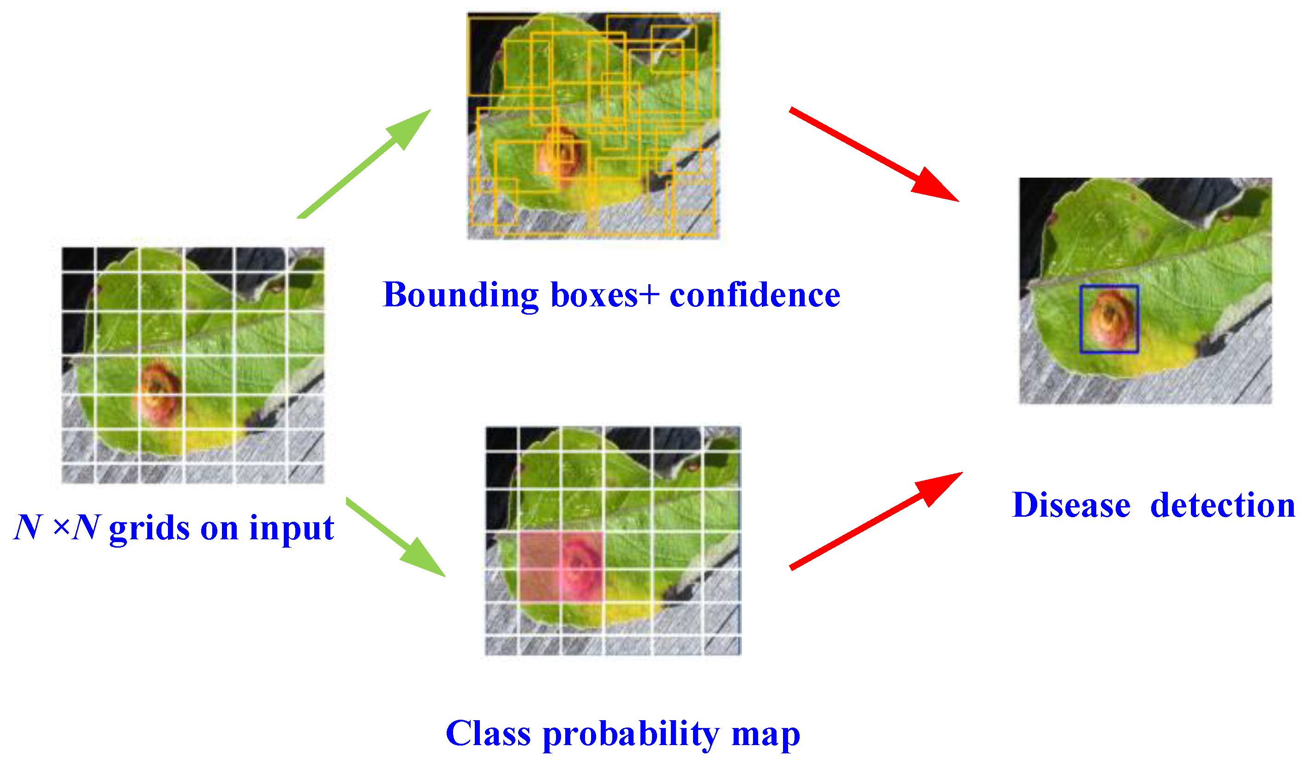
Infectious Disease Detection System

Slide 21
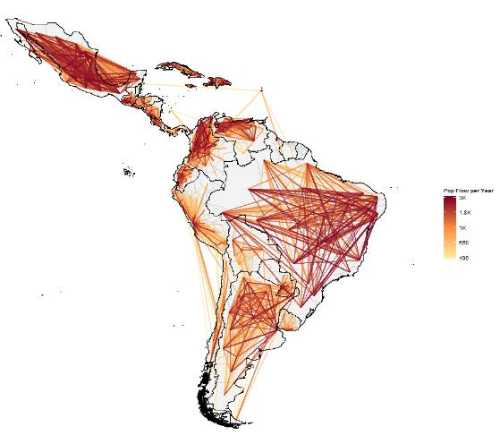
Population Movements and Connectivity

Slide 22
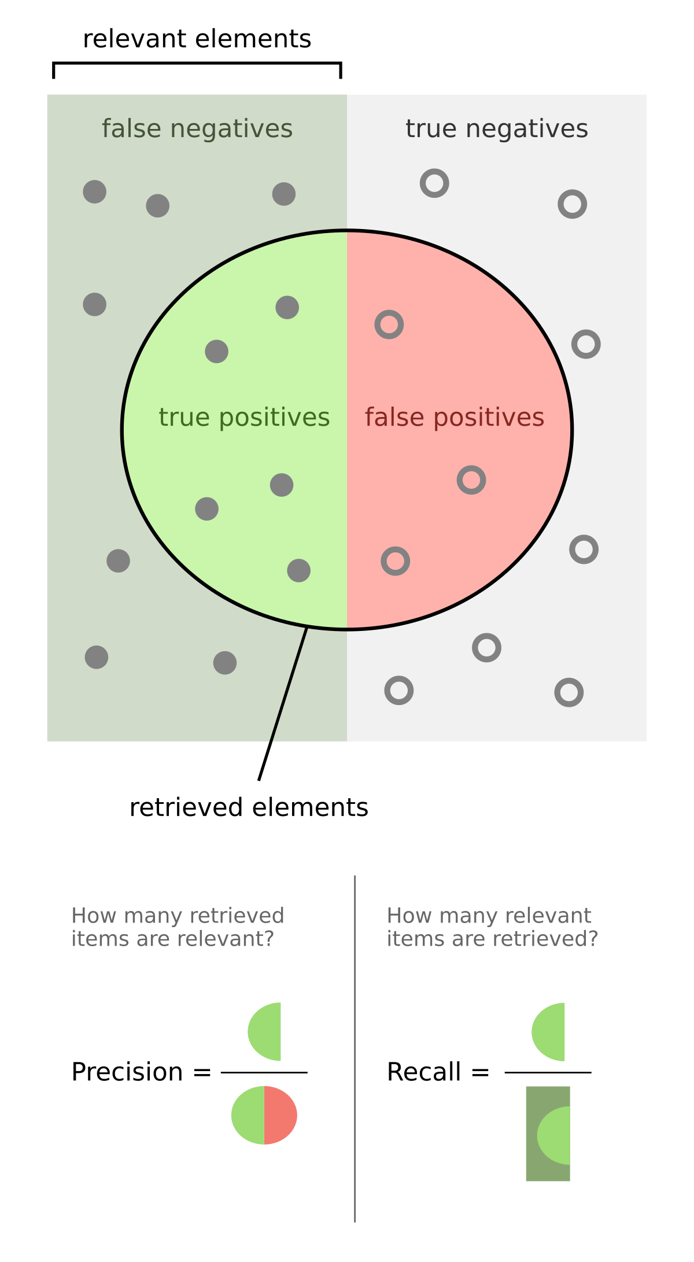
Process Chain of Geospatial AI
Pre-processing:
QA/QC, feature selection, cloud removing
Normalisation (DNN), labelling (classifications), augmentation
Model selection or architecture
Training / test set split
Random shuffled split (e.g., 7:3), stratified split, K-folding
Training
Early-stopping
Overfitting – L1, L2 penalty, Dropout (DNN)
Validation & hyperparameter fine-tuning
R² + MSE (regression)
Application
Feature importance, SHAP values
F1-score – recall + precision (classification)
Notes:
Learning rate, estimators, regularisation parameters, hidden neurons; GridSearchCV
If you want automatic feature selection → Use L1 (Lasso)
If all features are important but you want to reduce overfitting → Use L2 (Ridge)
If you want to combine the advantages of L1 and L2 → Use ElasticNet
4o

Slide 23
Tools & Libraries for Geospatial AI
Geospatial: GDAL, Rasterio, Geopandas
AI/ML: Scikit-learn, TensorFlow, PyTorch
Cloud Computing: Google Cloud Platform (GCP), Amazon Web Services (AWS), Microsoft Azure
Big Data: Google Earth Engine, ESA Portal, NASA Earth Data, ECMWF (European Centre for Medium-Range Weather Forecasts)

Slide 24
Challenges & Ethical Considerations in Geospatial AI
Bias in AI models
Data privacy issues

Slide 25
Summary & Discussion
AI + Geospatial Data: Combines AI techniques with geospatial data for advanced spatial analysis.
Applications: land classification, environmental monitoring, agriculture, urban planning, and disaster prevention.
Technologies: Remote sensing, GIS, and AI tools (e.g., CV and NLP).
Benefits: efficient, accurate, and scalable analysis of large geospatial datasets.
Challenges: data quality, privacy, computational demands, and requires interdisciplinary expertise.

Slide 26
Recommended further reading
Vaswani, Ashish, et al. "Attention is all you need." Advances in neural information processing systems 30 (2017).
Reichstein, Markus, et al. "Deep learning and process understanding for data-driven Earth system science." Nature 566.7743 (2019): 195-204.
Brown, Christopher F., et al. "Dynamic World, Near real-time global 10 m land use land cover mapping." Scientific Data 9.1 (2022): 251.
Zanaga, Daniele, et al. "ESA WorldCover 10 m 2021 v200." (2022).
Li, Yansheng, et al. "Accurate cloud detection in high-resolution remote sensing imagery by weakly supervised deep learning." Remote Sensing of Environment 250 (2020): 112045.

